Slide 1







Analyzing the Social Media Footprint of Street Gangs
Presented at IEEE International Conference on Intelligence and Security Informatics (IEEE ISI 2015) Baltimore, MD, USA, May 27-29, 2015
¹Sanjaya Wijeratne
sanjaya@knoesis.org
¹Derek Doran
derek@knoesis.org
¹Amit Sheth
amit@knoesis.org
²Jack L. Dustin
Jack.dustin@wright.edu
¹Ohio Center of Excellence in Knowledge-enabled Computing (Kno.e.sis)
²Center for Urban and Public Affairs (CUPA)
Wright State University, Dayton, OH, USA

Slide 2

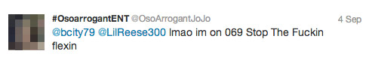
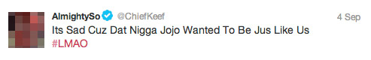
Tweets Source – http://www.wired.com/2013/09/gangs-of-social-media/all/ Image Source – http://www.7bucktees.com/shop/chi-raq-chiraq-version-2-t-shirt/
Notes:
Tweets Source - http://www.wired.com/2013/09/gangs-of-social-media/all/
Image Source - http://www.7bucktees.com/shop/chi-raq-chiraq-version-2-t-shirt/

Slide 3

What does gang related research tell us?
“Gangs use social media mainly to post videos depicting their illegal behaviors, watch videos, threaten rival gangs and their members, display firearms and money from drug sales” [Patton 2015, Morselli 2013]
Studies have shown,
82% had used the Internet and 71% of them had used social media [Decker 2011]
45% participated in online offensive activities and 8% recruited new members online [Pyrooz 2013]
Image Source – http://www.sciencenutshell.com/wp-content/uploads/2014/12/o-GANG-VIOLENCE-facebook.jpg
Notes:
Image Source - http://www.sciencenutshell.com/wp-content/uploads/2014/12/o-GANG-VIOLENCE-facebook.jpg

Slide 4
Gang related research cont.
“Someone says something to me on Facebook, I don't even write a word. The only thing I do is post my 30-popper, my big banger”¹
¹http://www.wired.com/2013/09/gangs-of-social-media/all/
Image Source – http://www.sciencenutshell.com/wp-content/uploads/2014/12/o-GANG-VIOLENCE-facebook.jpg
Notes:
Image Source - http://www.sciencenutshell.com/wp-content/uploads/2014/12/o-GANG-VIOLENCE-facebook.jpg

Slide 5
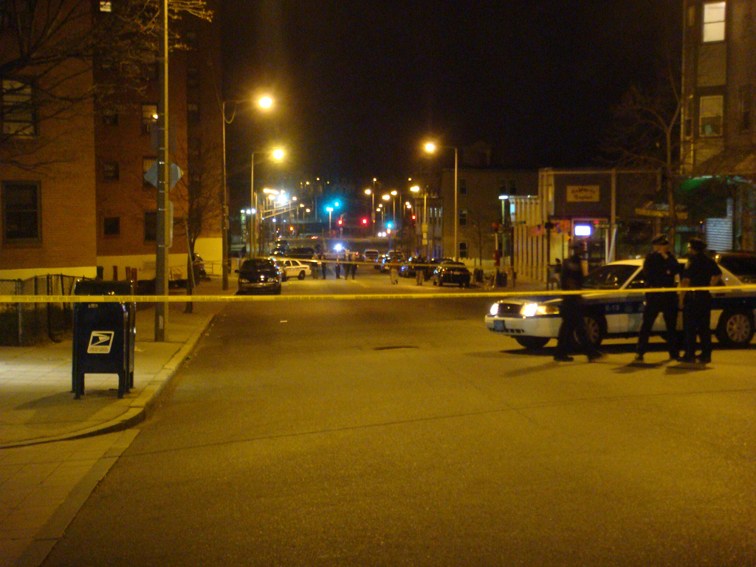
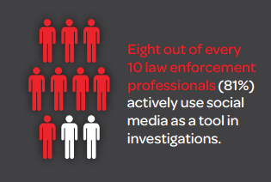
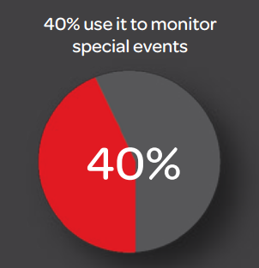
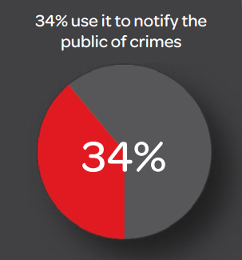
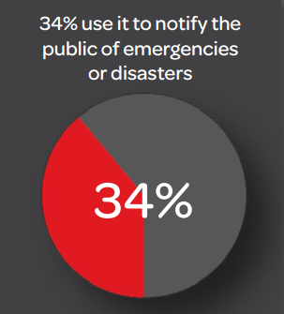
There are other spectators too…
Source – http://www.lexisnexis.com/risk/downloads/whitepaper/2014-social-media-use-in-law-enforcement.pdf
Image Source – http://www.officialpsds.com/images/stocks/crime-scene-stock1016.jpg
Notes:
Image Source - http://www.officialpsds.com/images/stocks/crime-scene-stock1016.jpg

Slide 6
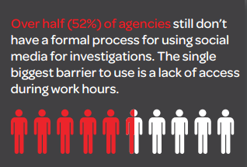
But there’s a problem…
Source – http://www.lexisnexis.com/risk/downloads/whitepaper/2014-social-media-use-in-law-enforcement.pdf
Image Source – http://www.officialpsds.com/images/stocks/crime-scene-stock1016.jpg
Notes:
Image Source - http://www.officialpsds.com/images/stocks/crime-scene-stock1016.jpg

Slide 7

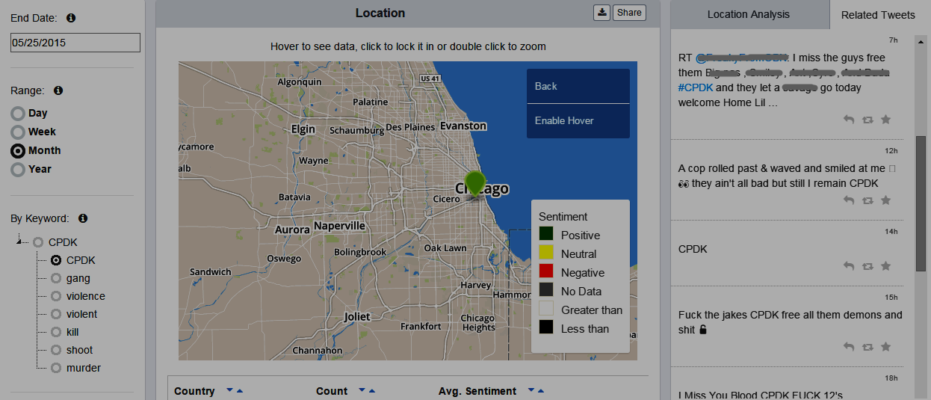
A platform to analyze social media
Monitor negative community effects of gang activities
Discover opinion leaders who influence the thoughts and actions of other gang members
Evaluate the sentiment of posts targeting communities, locations, and groups

Slide 8
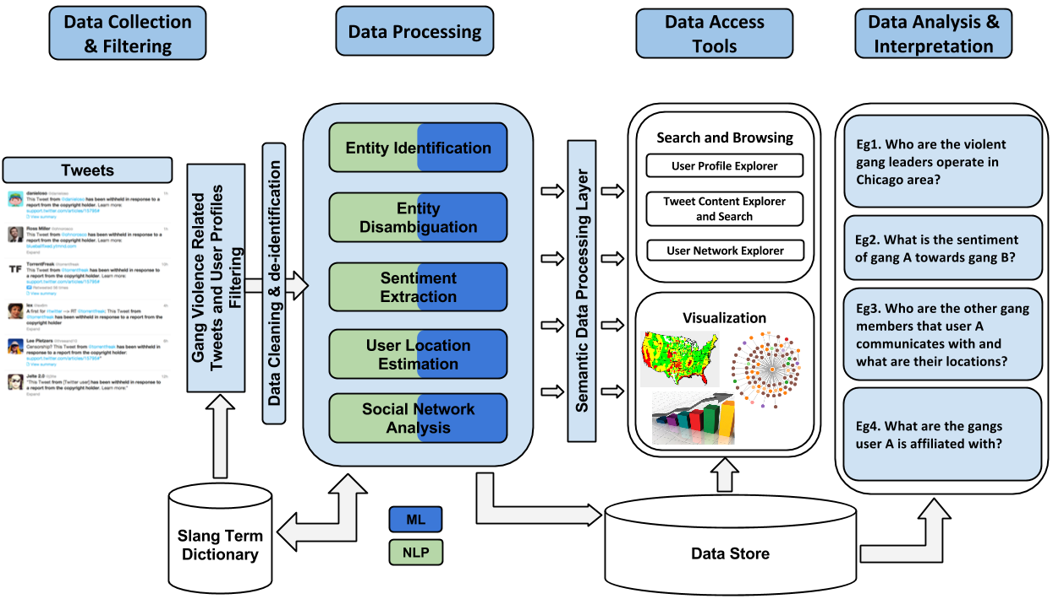
Architecture of our platform

Slide 9

Data collection
 | Gang Related Dataset | Location Related Dataset
Data Collection | 91 known gang member profiles from a Chicago gang (Gang X) + Gang related keywords (eg. #BDK, #GDK etc.) [Decary-Hetu 2011] | 10 neighborhoods in Chicago - South Landale, North Landale, West Elsdon, Gage Park, West Lawn, Chicago Lawn, New City, Humboldt Part, Logan Square and Belmont Cragin
APIs | Twitter REST + Twitter Streaming | Twitter Streaming
Size | 56,368 + 49,079 = 105,447 | 383,656
Geo Information | 57.07% | 100%
Image Source – http://goo.gl/iCTDj4
Notes:
Image Source - http://www.wallpaperup.com/25695/information_technology_big_data_collection_complex_database_physics_programming_code_numbers_tunnels_3d_cg_digital_art_light_psychedelic_computer.html
56368 Tweets from 91 gang members

Slide 10
Spatio-Temporal-Thematic Analysis
lemme hear you say Gang X and we finna murder you
On location_name We Drillin Fuck Da Opps
@user1 @user2 check out this 7414 track, url_to_file
Notes:
Image Source -

Slide 11
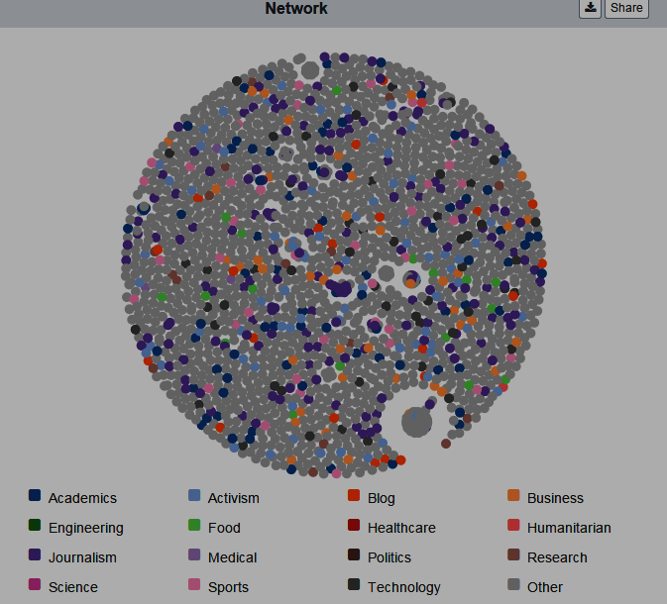

People-Content-Network Analysis
Nodes – 1,322
Edges – 19,539
Avg. Degree – 14.77
# of Clusters – 72
Modularity – 0.859
Avg. Nodes in a Cluster – 15
Notes:
Image Source -

Slide 12
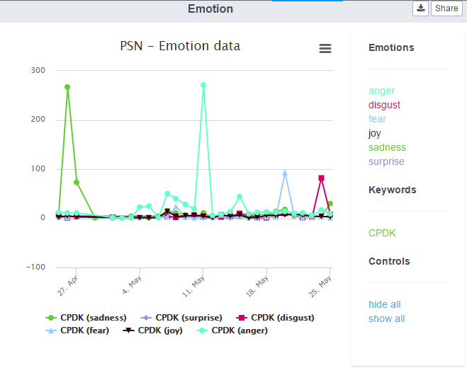
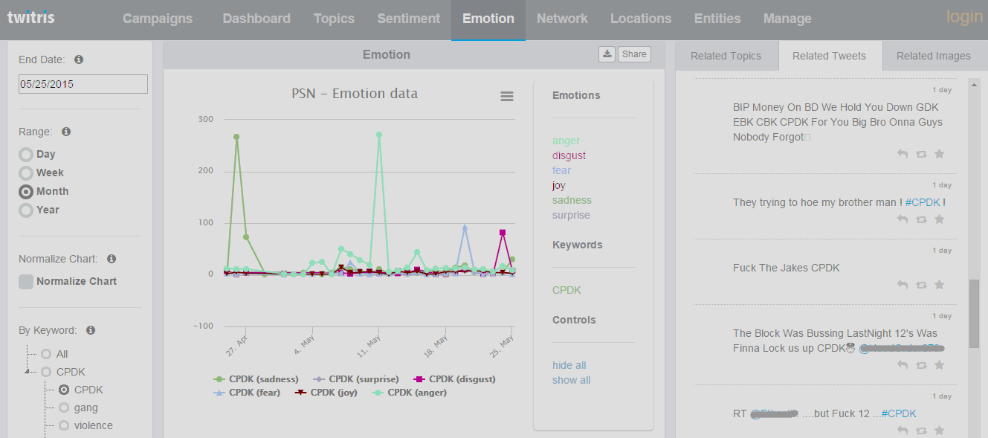
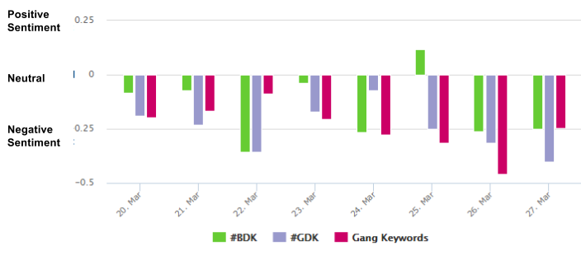
Sentiment-Emotion Analysis
Notes:
Image Source -

Slide 13
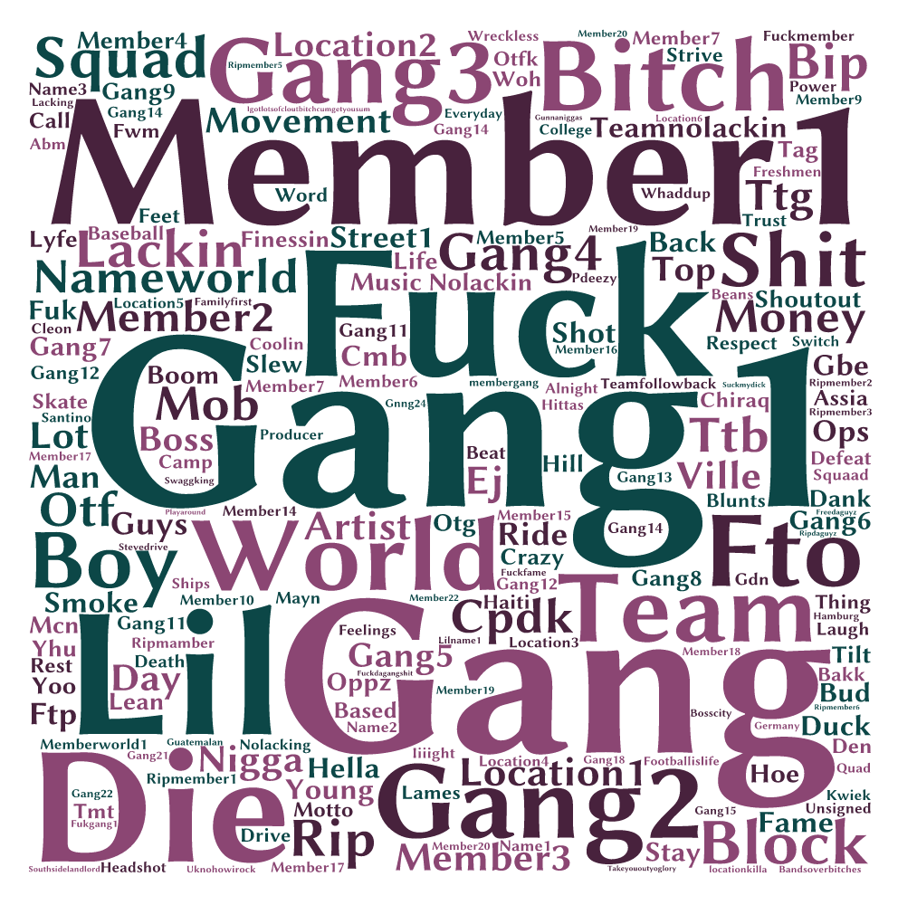

Twitter profile analysis
Notes:
Image Source -

Slide 14

Challenges and Future work
Automatically identify gang member profiles on Twitter
Automatically detect beefing among gangs
Integrate additional slang dictionaries
Hipwiki.com
Improve sentiment analysis algorithm
Evaluating the findings
Beefing identified by the system VS beefing taken place in the real world
Filter noisy data (Wijeratne 2014)
Image Source – http://i.ytimg.com/vi/dqyYvIqjuFI/maxresdefault.jpg
Notes:
Image Source - http://i.ytimg.com/vi/dqyYvIqjuFI/maxresdefault.jpg

Slide 15




Connect with me
sanjaya@knoesis.org
@sanjrockz
http://bit.do/sanjaya
Image Source – http://www.pcb.its.dot.gov/standardstraining/mod08/ppt/m08ppt23.jpg
Notes:
Image Source - http://www.pcb.its.dot.gov/standardstraining/mod08/ppt/m08ppt23.jpg

Slide 16
References
[1] D. U. Patton, “Gang violence, crime, and substance use on twitter: A snapshot of gang communications in Detroit,” Society for Social Work and Research 19th Annual Conference: The Social and Behavioral Importance of Increased Longevity, Jan 2015
[2] C. Morselli and D. Decary-Hetu, “Crime facilitation purposes of social networking sites: A review and analysis of the cyber banging phenomenon,” Small Wars & Insurgencies, vol. 24, no. 1, pp. 152–170, 2013
[3] S. Decker and D. Pyrooz, “Leaving the gang: Logging off and moving on. Council on foreign relations,” 2011

Slide 17
References Cont.
[4] D. C. Pyrooz, S. H. Decker, and R. K. Moule Jr, “Criminal and routine activities in online settings: Gangs, offenders, and the internet,” Justice Quarterly, no. ahead-of-print, pp. 1–29, 2013
[5] D. Decary-Hetu and C. Morselli, “Gang presence in social network ´ sites,” International Journal of Cyber Criminology, vol. 5, no. 1, 2011
[6] S. Wijeratne and B. R. Heravi, “A keyword sense disambiguation based approach for noise filtering in twitter,” 2014

